Slide 1
MODES OF PERSUASION
Writing workshop #3

Slide 2
A soft instrumental symphony plays in the background of a commercial asking for donations.
LOGOS
PATHOS
ETHOS

Slide 3
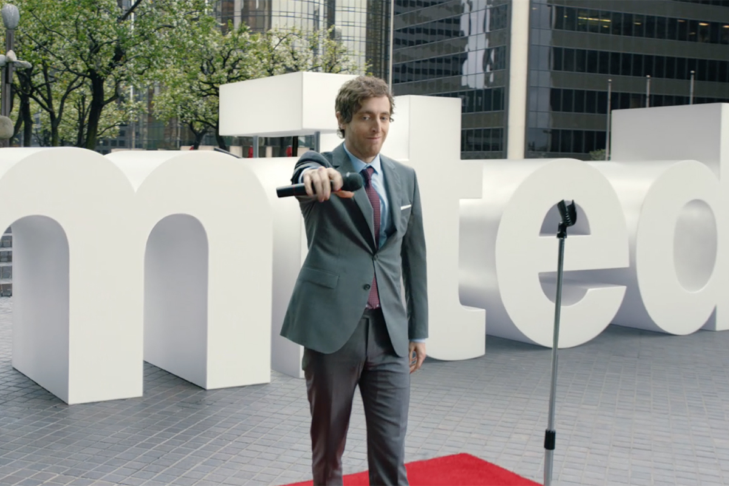
LOGOS
PATHOS
ETHOS

Slide 4
Fair trade agreements have raised the quality of life for coffee producers, so fair trade agreements could be used to help other farmers as well.
LOGOS
PATHOS
ETHOS

Slide 5
LOGOS
PATHOS
ETHOS

Slide 6
“And so even though we face the difficulties of today and tomorrow, I still have a dream. It is a dream deeply rooted in the American dream.”
LOGOS
PATHOS
ETHOS

Slide 7
“Our expertise in roofing contracting is evidenced in the decades of satisfied customers who have come to expect nothing but the best.”
LOGOS
PATHOS
ETHOS

Slide 8
LOGOS
PATHOS
ETHOS

Slide 9
LOGOS
PATHOS
ETHOS

Slide 10
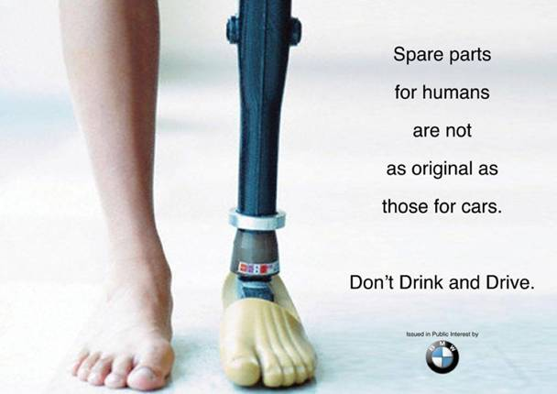
LOGOS
PATHOS
ETHOS

Slide 11
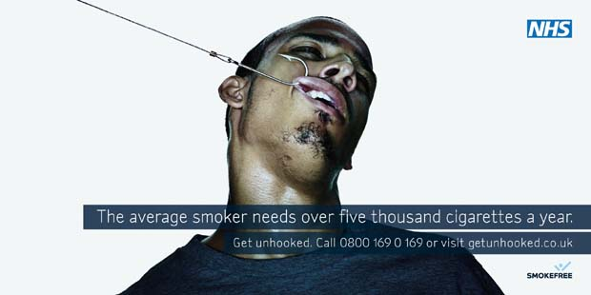
LOGOS
PATHOS
ETHOS

Slide 12
All men are mortal.
Socrates is a man.
Therefore, Socrates is mortal.
LOGOS
PATHOS
ETHOS

Slide 13
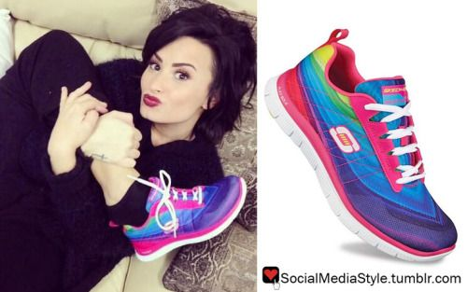
LOGOS
PATHOS
ETHOS

Slide 14
“If his years as a soldier taught him anything, it’s that caution is the best policy in this sort of situation.”
LOGOS
PATHOS
ETHOS

