Slide 1
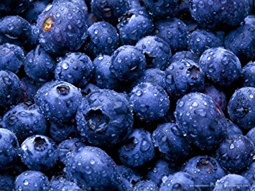
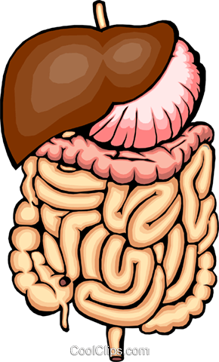
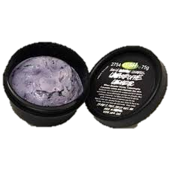
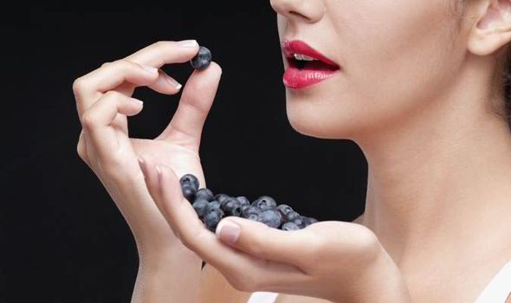
NUTRITIOUS
GOOD
HEALTH
NUTRITIOUS
GOOD HEALTH
VERSATILE
EAT MORE
BLUEBERRIES!
VERSATILE

Slide 2
WRONG!!!!! DO NOT DO THIS!!!!
NUTRITIOUS
Blueberries contain 25% of your daily Vitamin C.
Vitamin C helps repair broken blood vessels and form scare tissue.
Vitamin C helps produce collagen, keeping your skin strong.
Blueberries contain 3.5 gram of fiber, or 7% of your daily intake.
Fiber creates intestinal defense mechanisms.
Fiber regulates digestion.

Slide 3
VISUAL AID IDEAS
Poster
PowerPoint presentation
Photo slideshow
Video clips
Music
Write on board
Props
Diagram / chart
Individual handouts
Food
Performance

Slide 4
VISUAL AID TIPS
Limited words
No complete sent.
Easy-to-see images
Cartoons
Brightness
Easy-to-see words
Size 24+
Dark fonts
No-competing backgrounds
Timing
Not distracting
Engaging

Slide 5
FINAL SPEECH TIPS
Say speech out loud!
Practice in front of mirror!
Time yourself!
MULTIPLE TIMES!!!
Film your speech!
Assess yourself using rubric!
Make necessary adjustments!
Practice for parents!
Dress for success!

