Slide 1
SOCIAL MEDIA CAMPAIGNS: THE FIGHT AGAINST DISCRIMINATION
WRITING WORKSHOP #2

Slide 2
#weareallmonkeys
FIFA games 2014
Banana thrown at dani alves
Alves ate banana; threw rest away
Teammate neymar 1st to support
#weareallmonkeys
Results:
Players from all teams posting hashtag & picture
The Marca – changed “A” to three bananas
Italian Prime Minister = anti-racist shot of potassium
Brazilian President tweeted support
FIFA policy changes

Slide 3
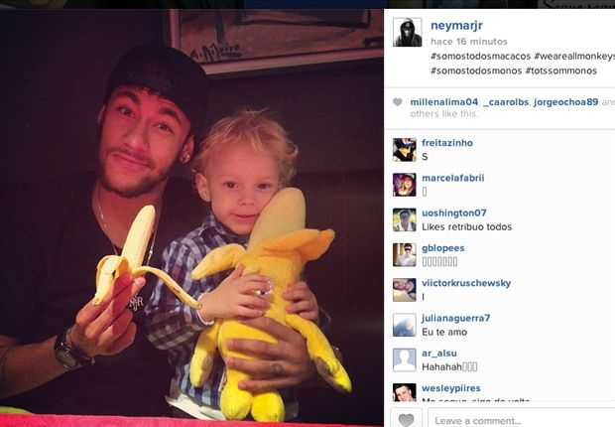

Slide 4
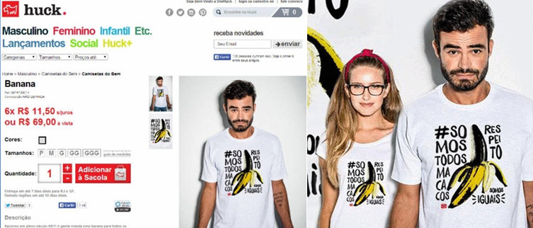

Slide 5
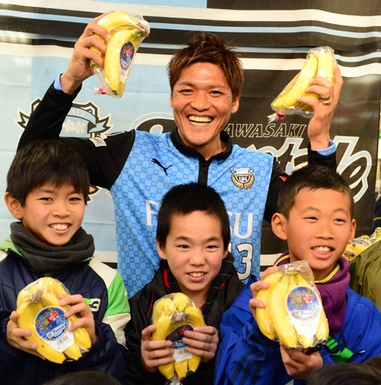

Slide 6
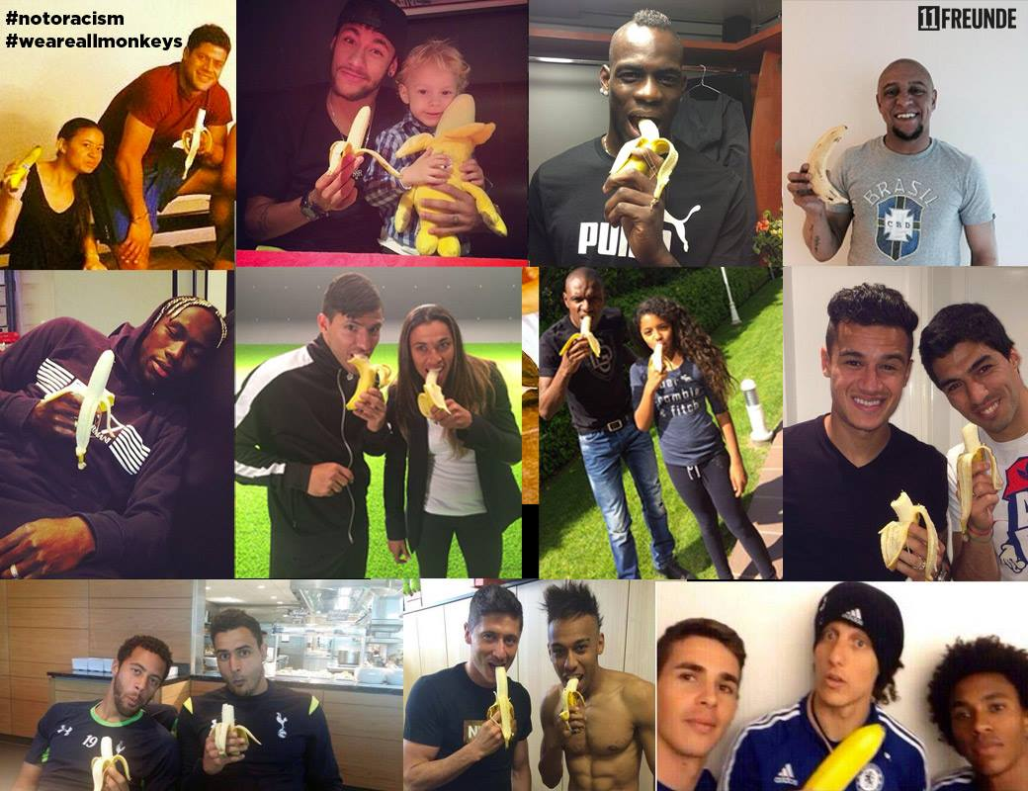

Slide 7
FREE & EQUAL
United Nations Human Rights Office
Social media campaign combatting discriminations of LGBTI around the world
Youtube = video release; millions viewed
Ted talks
Documentary films
Celebrity support (e.g. “same love”)
#Loveislove
#celebratelove

Slide 8
WATER IS LIFE
Goal = clean water for all
Hashtag killer technique
Angry at original hashtag
#FirstWorldProblems → support for water is life
Coined term
Encouraged donations
Over 1 million days worth of clean water

Slide 9
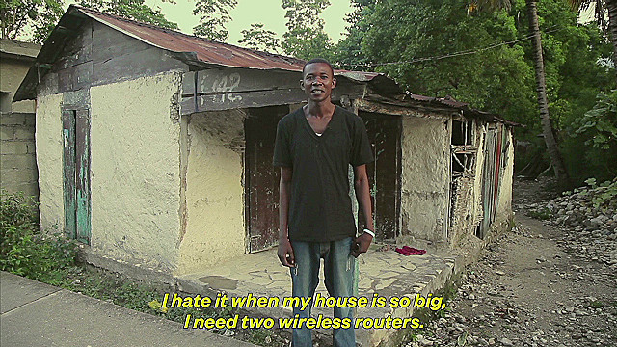
#FIRSTWORLDPROBLEMS

Slide 10
ALS ICE BUCKET CHALLENGE
#alsicebucketchallenge
All videos = over 1 billion views on youtube
3 million people/organizations donated
110 million in total donations
3 million raised for als therapy development

Slide 11
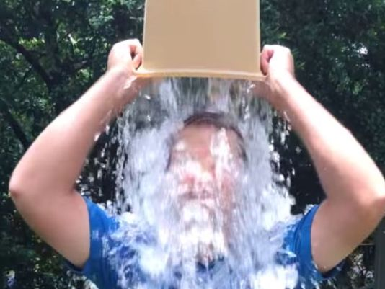
CHRIS KENNEDY = 1st CONNECTED

