Slide 1

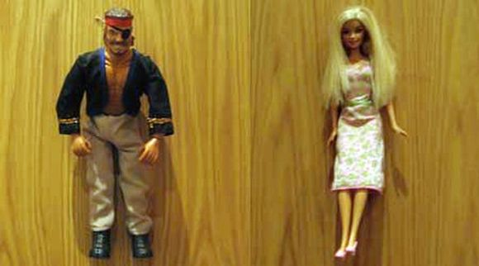


How to…
Be Excused for the Restroom!

Slide 2



WHY?????
You don’t need to…
… feel uncertain about if you can go.
… feel uncomfortable asking to go.
… wait for my permission.
… interrupt class instruction.

Slide 3

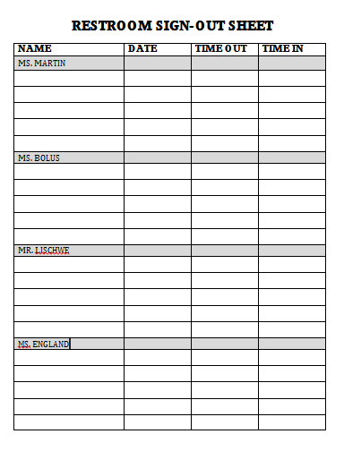

How to…
Be Excused for the Restroom!
You do not need to ask permission!

Slide 4
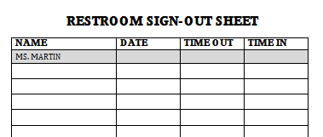

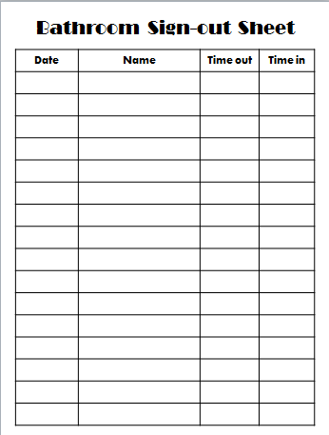

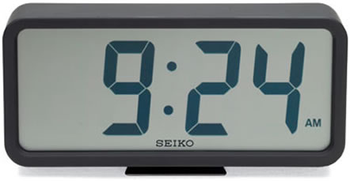
8-8-17
9:24
9:27

Slide 5

Some Exceptions…
Testing
Guest speaker
Safety Drill
VACANT
OCCUPIED
You may use the restroom.
Don’t think about water.

Slide 6



Step-by-step Directions:
Check the cue sign.
Fill out the sign-out sheet.
Take appropriate pass.
Handle your business.
Return pass.
Fill out time in.
VACANT

Slide 7
ONE LAST THING….
Only FIVE passes per semester!!!!

