Slide 1
IMMIGRATION BASICS
Enrique’s journey

Slide 2
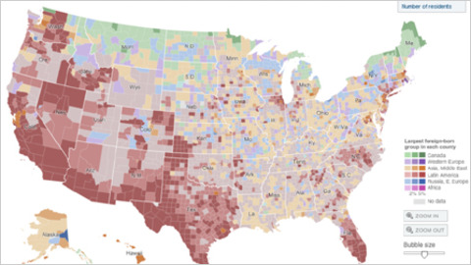
POPULATION STATISTICS
42.2 million immigrants
13% of US population
India, China, Mexico, Canada, Philippines (origin)
California, Texas, New York, Florida, New Jersey (living)
28% Mexican/Latino
11 million illegal immigrants
11 million lawful residents, temporary visa

Slide 3
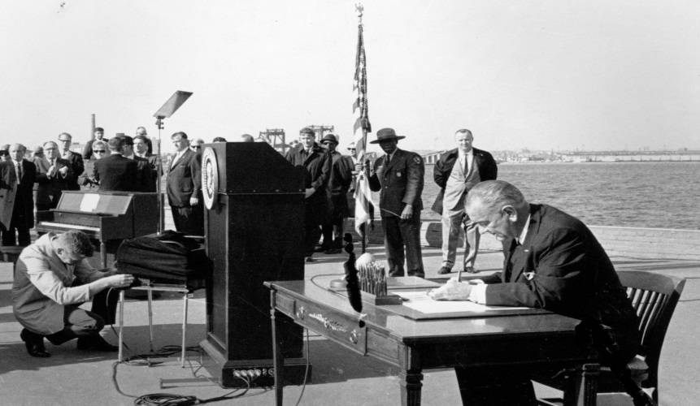
IMMIGRATION POLICY - INA
INA (The Immigration Naturalization Act)
675,000 immigrants yearly
Additional temporary basis
Additional refugee
Limits per country
Purpose
Reunite families (spouse, minor children, parents of citizens)
Employment (temp. jobs, special skills, religious workers)
Refugees (fear of persecution)
Diversity (cultural benefits, opportunities for low countries)

Slide 4
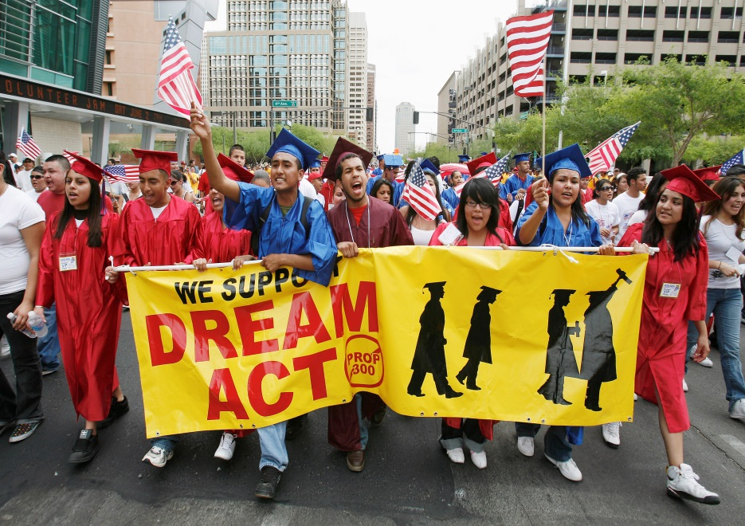
IMMIGRATION POLICY - DREAM
DREAM (Development, Relief, and Education for Alien Minors)
Goal = residency for undocumented immigrants
Requirements = HS diploma, good character, no crime
Never adopted; 20 states with own version
Pros
Decrease deportation sending
Increase job market
Increase military
Cons
Shield gang members
Encourage illegal immigrations
Chain migration
Public funding
New Proposal
Pathway to legalization
No sponsoring of family members
Trump indicated support

Slide 5
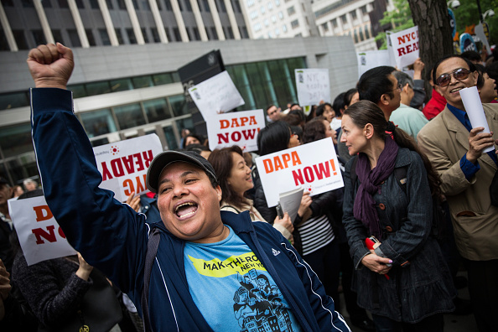
IMMIGRATION POLICY - DACA
DACA (Deferred Action for Childhood Arrivals)
Renewable two-year period to defer deportation
Directed toward immigrant children who grew up in US
Requirements = pre-16 entering, HS or GED, clean record
NO PATH TO CITIZENSHIP
Outcome
750,000 applications approved
(June, 2016)
Increase labor force participation
(75,000)
States= individual benefits policies
Current Status
Terminated by the Trump Administration
No longer accepting new applications/allowing renewals
Ends in March 2018
Those under DACA will be considered illegal
800,000 people
As of yesterday, Trump open to new policy?

Slide 6
IMMIGRATION PROCESS
Green Card
Requirements = relatives, job, refugee
Priority → date, category, country of origin
Limited number of visas available
Citizenship
18 years or older
Lawfully admitted permanent resident
Resident for 5 years
Continuous permanent residency
Good moral character
US Constitution principles
Basic English
US history / government

Slide 7
Travel Ban (3rd Version)
Restrictions on travel for 8 nations (6 Muslim)
Iran, Libya, Syria, Yemen, Somalia, Chad, North Korea, Venezuela
Unable to immigrate permanently
Many barred from working, studying, or vacationing
Overrules previous compromise to allow travel with connections
Legal due to “protect national security”

Slide 8
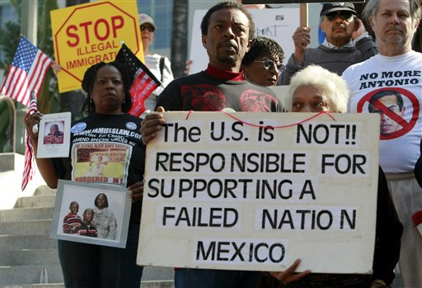
IMMIGRATION CONS
Terrorism / crimes
Take jobs
Immigration control costs
Increased population
Take scholarships
Law violation

Slide 9
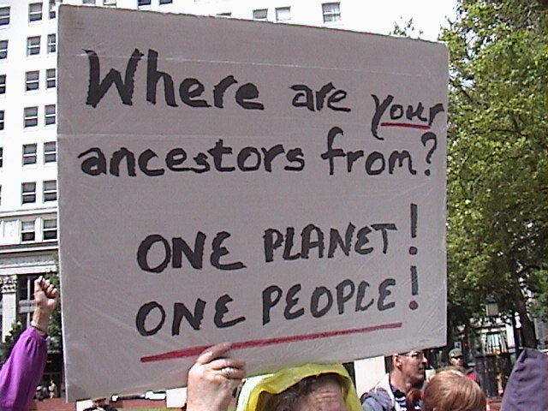
IMMIGRATION PROS
Lower labor costs
Undesirable jobs
Pay taxes
Richer culture
Deportation costs
Civic duty

