Slide 1
Enrique’s journey By: Sonia Nazario
Maps and Introduction

Slide 2
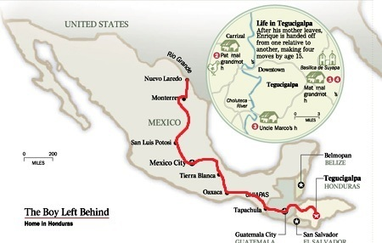
Notes:
The above image shows Enrique’s journey to the United States-Mexican border.
The image in the circle shows how Enrique moved in Tegucigalpa

Slide 3
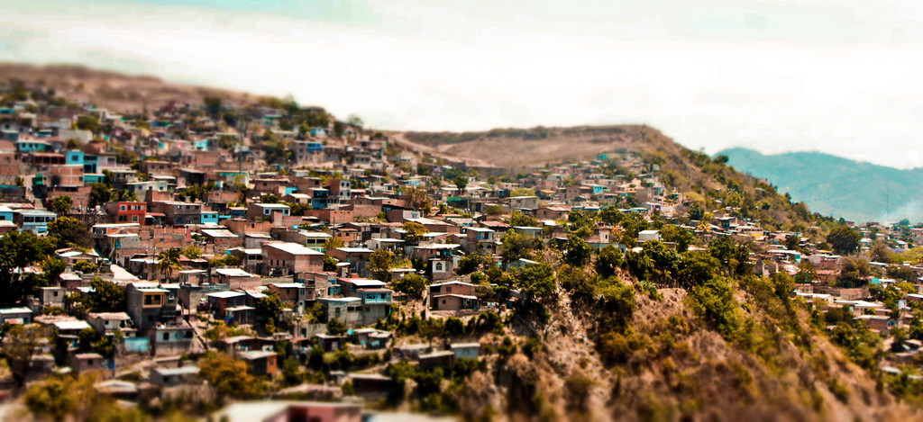
Above is a hillside in Tegucigalpa, Honduras. What do you notice?

Slide 4
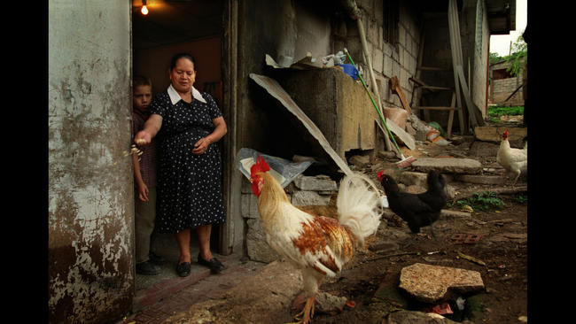
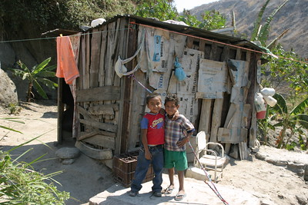
Pictured below are the types of homes the impoverished in Tegucigalpa live in. They can range from houses like those on the left, Enrique’s maternal grandmother’s home, to the right which shows a home from the “shanty towns” on the hillside.

Slide 5
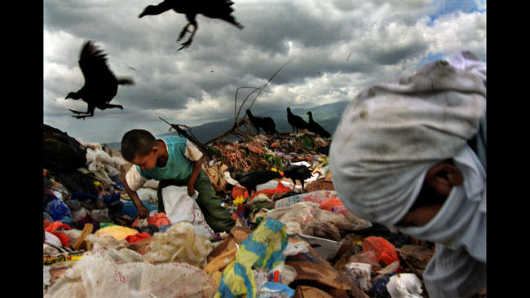
Above a boy competes with buzzards for trash in the dump in Tegucigalpa.
Without his mother sending money from the U.S. the same fate may have awaited Enrique.

Slide 6
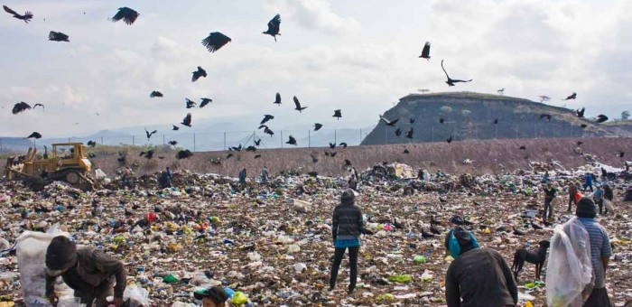
Hundreds of men, women, and children pick through this every day. The poor hope to find food to eat or cardboard and plastic to sell.

Slide 7
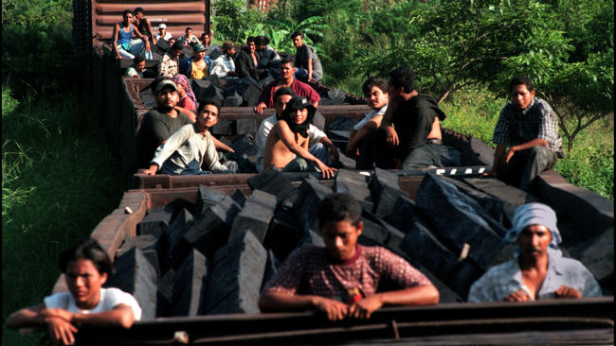
Notes:
Immigrants riding train after jumping on.

Slide 8
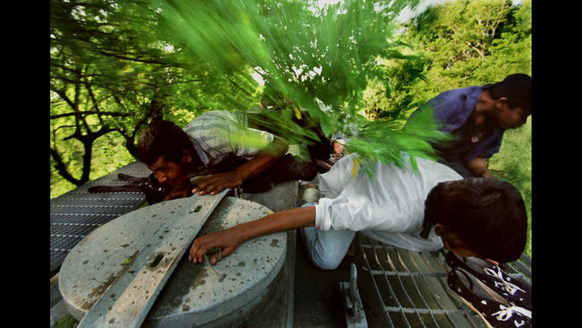
Unlike the previous photo most migrants hang onto the sides of the train to be prepared to jump off. They also will ride on top but have to be aware of low hanging branches.

Slide 9
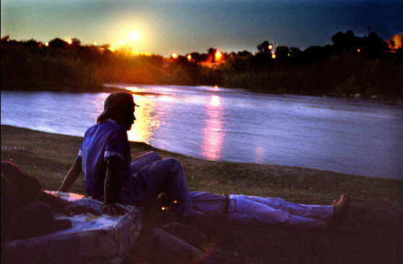
The perilous journey all leads to here. Above migrants look on from the Mexican side of the Rio Grande. In the distance, U.S. Border Patrol lights illuminate Zacate Creek in Texas.

Slide 10
Works Cited
Nazario7, Sonia. "Enrique's Journey." Los Angeles Times. Los Angeles Times, Oct. 2002. Web. 25 Jan. 2017.
(Photo Credit)

