Slide 1
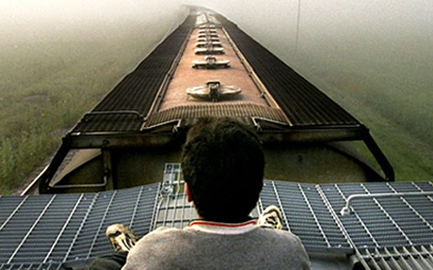
Enrique’s Journey
By: Sonia Nazario

Slide 2
Immigration to the United States
New Immigration Wave:
Divorce / separation → single mothers with no income
Shift from fathers leaving to mothers leaving
Children Left Behind:
“Did my mother leave because she never truly loved me? How else can I explain why she left?” (Nazario, 5)
Set out to go to their mothers

Slide 3
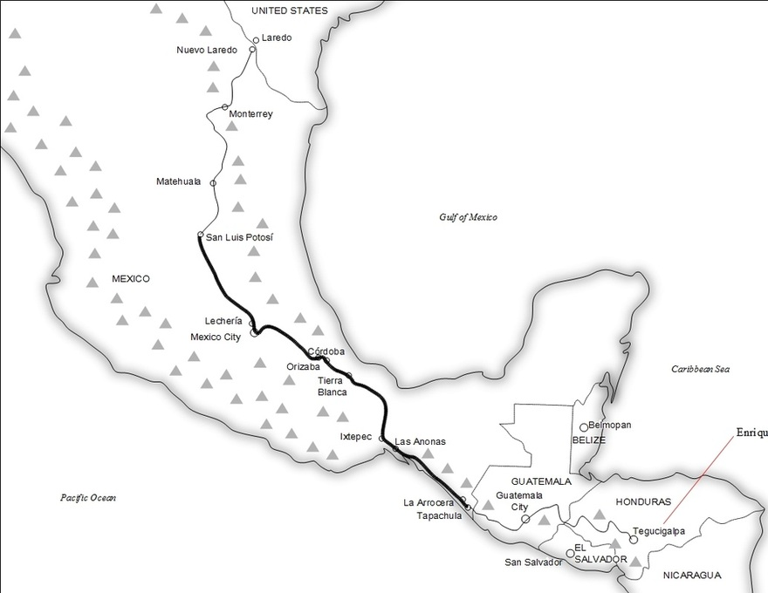
The Journey
Riding atop trains
-El Tren de la Muerte
Bandits
Gangs
Border Patrol
Migrant Officers
Starvation, Injury, and violence

Slide 4
Nazarios’ Journey to Enrique
Carmen’s Story
Author’s house keeper (Carmen)
Left four children for better life in the United States
Find a better life for THEM
Carmen’s son arrive in LA after 13 years
Unable to bear the separation
Nazario intrigued by this concept
“What kind of desperation pushes children as young as seven to set out, alone, through such hostile landscapes with nothing but their wits?” (Nazario, 5).

Slide 5
Nazarios’ Journey to Enrique (Continued)
Telling the Story
Nazario = journalist
Embarks to tell this story from the inside out
Find a teenager and follow him to the border
Authorities/Government made aware
Getting to Enrique
Nazario found Enrique through a nun in Nuevo Laredo
Nazario traveled to Central America
Interviewed his family

Slide 6
Book Synopsis
Enrique’s Journey recounts the unforgettable odyssey of a Honduran boy who braves unimaginable hardship and peril to reach his mother in the United States.
Enrique’s mother, Lourdes, left when he was only five to find a better life for her children in the U.S.
Planning only to stay until she can send for her children or return with enough money to support them, Enrique’s mother promises to bring him to be with her, but each year setbacks prevent her from keeping her promise.
Unable to bear the separation any longer, Enrique begins his journey to get to her.

Slide 7
Works Cited
Nazario, Sonia. Enrique's Journey. New York: Random House, 2006. Print.

