Slide 1
THE PROGRESSION OF THE HOLOCAUST
The Diary of Anne Frank

Slide 2
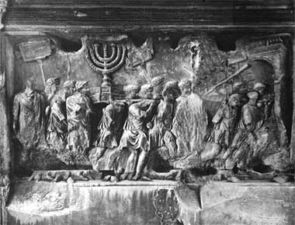
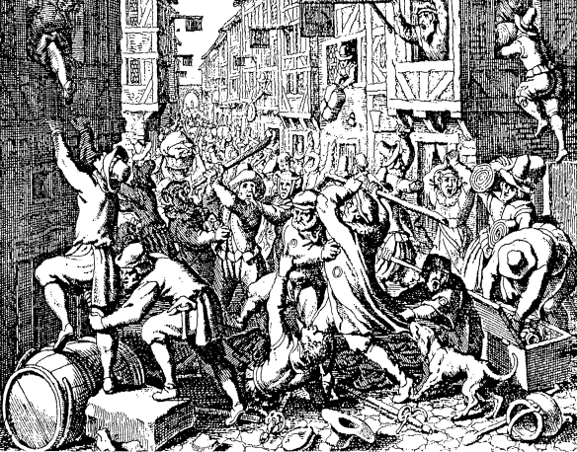
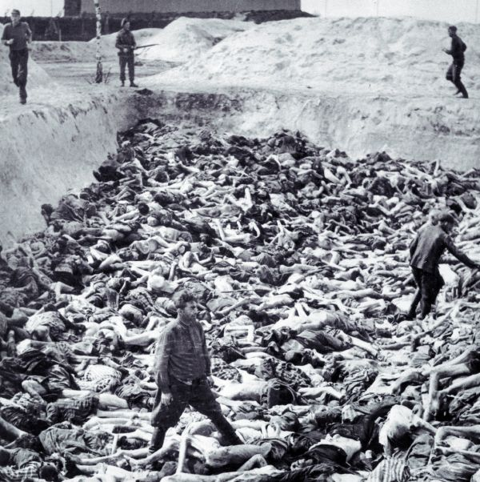
A Brief History of Discrimination...
Early Christian times
Jews asked to convert
“You have no right to live among us.”
15th Century
Jews confined in ghettos
“You have no right to live among us.”
Holocaust
“You have no right to live.”

Slide 3
What was the holocaust?
Holocaust = Under the Nazis, the goal of the German government to kill ALL Jewish people in Europe by implementing a step-by-step plan enforced by government workers
Populations Targeted:
Six million Jews
250,000 gypsies
250,000 mentally/physically
impaired
Communists
Socialists
Jehovah’s Witnesses
Homosexuals

Slide 4
the Four Legalized Stages
Definition
Expropriation
Concentration
Annihilation

Slide 5
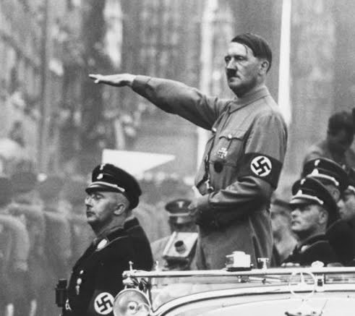
Building Background:
How did the Holocaust Progress?

Slide 6
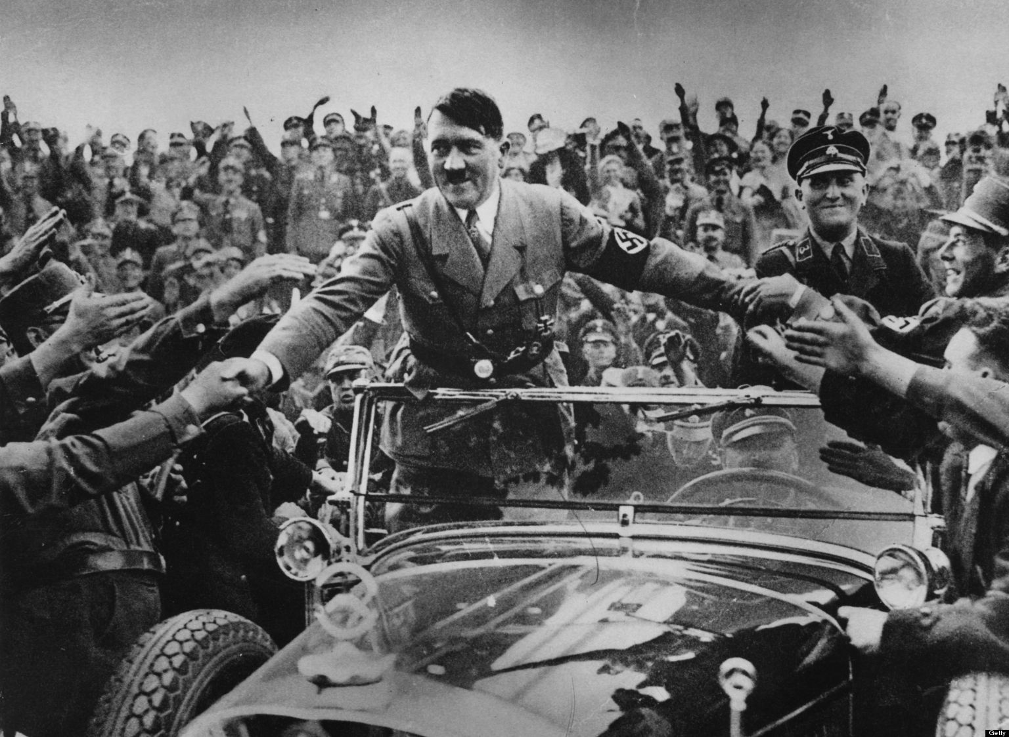
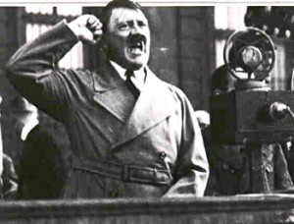
Stage #1: Definition Early 1930-1937
Jews defined as inferior race
1933
Hitler = Chancellor
The Enabling Act = dictatorship
Racial Ideology
Germans = master race
Jews = inferior race
“All great cultures of the past perished only because the originally creative race died out from blood poisoning.” - Hitler

Slide 7
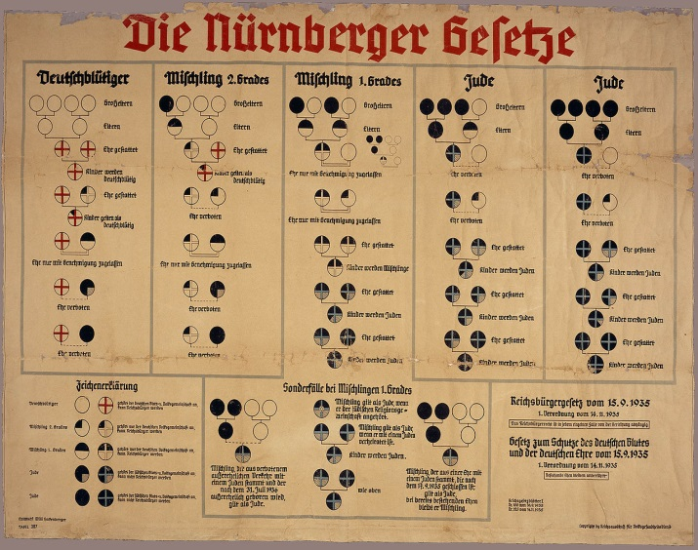
Stage #1: Definition
1933 Laws: Jews must…
Quit civil service jobs
Quit court positions
Quit university positions
1935 Nuremberg Laws: Jews must…
Become second-class citizens
Register for “Jew” ID cards
Label “Jew” on businesses, clothes, and passports

Slide 8
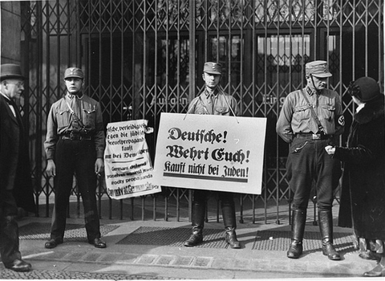
Stage #2: Expropriation 1937-1939
Jews forced from Germany’s economic life
Nazis seized Jewish businesses
Nazis seized Jewish properties
Jews forced to sell belongings
Jews = no bank accounts
GERMANS!
Defend yourselves! Do not buy from Jews!

Slide 9
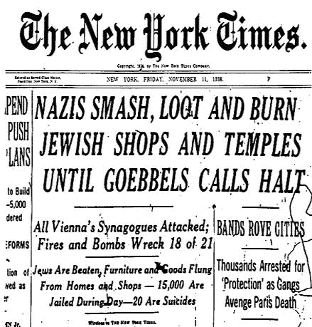
Stage #2: Expropriation the night of broken glass
[Who]: Kristallnacht
What: Organized riot
When: 9-10 November 1938
Where: Germany & Austria
Why: Jew destruction
Goebbel’s excuse = diplomat murder
Propoganda
How: taunted, beaten, humiliated, murdered, vandalized…

Slide 10
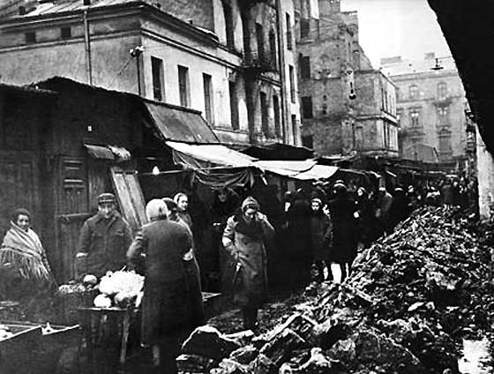
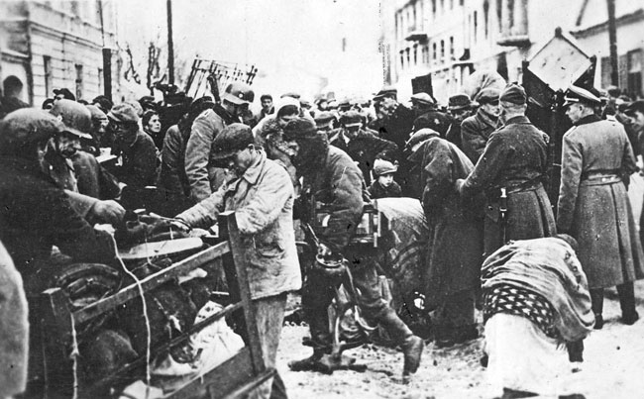
Stage #3: Concentration Early 1930 – 1939 intensified
Intensified series of Jewish restrictions
No school
Restricted travel
Restricted use
No phones
No camera
No radios
No pets
Moved to ghettos
Slave laborers
Limited supplies
Limited shelter
Cold
Disease
Overcrowding

Slide 11
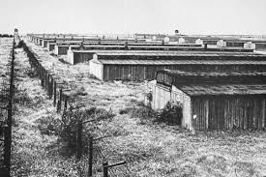
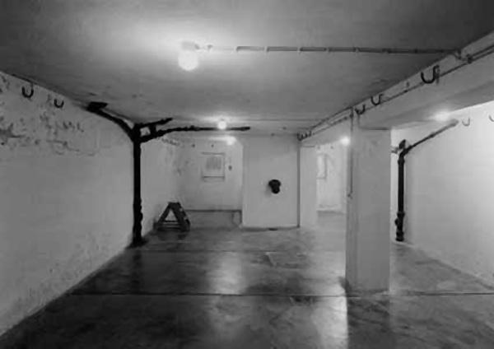
Stage #4: Annihilation 1941 - 1945
Large-scale killings of Jews
Concentration Camps
Belzec
Sobibor
Treblinka
Chelmno
Majdanek
Auschwitz-Birenau
Mass Killings
Gas chambers
Mass shootings
Disease
Starvation

