Slide 1
Cast Members
The diary of anne frank

Slide 2
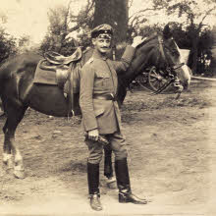
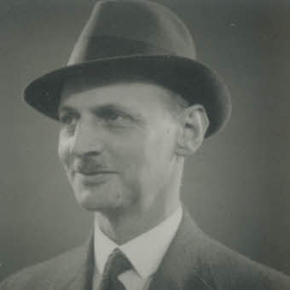
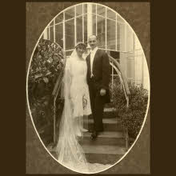
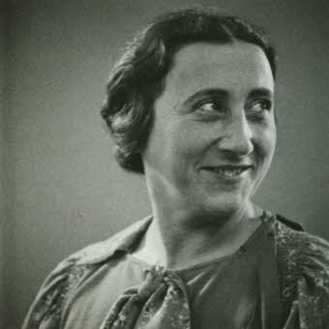
Members of the Annex-The Frank Family
Otto Frank
Served in German army as a Lieutenant in World War I
Created own business selling materials to make homemade jam
Set up the annex for the families to live in
In the annex he was known to be the leader of the group, calm, and a teacher for the children.
Edith Frank
Grew up in a middle class Jewish family
Stayed home to care for her two daughters
In the annex she was known to be a caretaker, reserved, and submissive.
*The family tried to leave the Netherlands and escape to the U.S. but failed. Eventually it became too dangerous for them in the Netherlands , and they were forced to stay and go into hiding.*

Slide 3
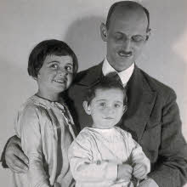
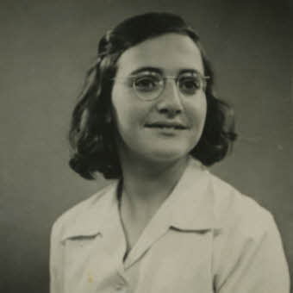
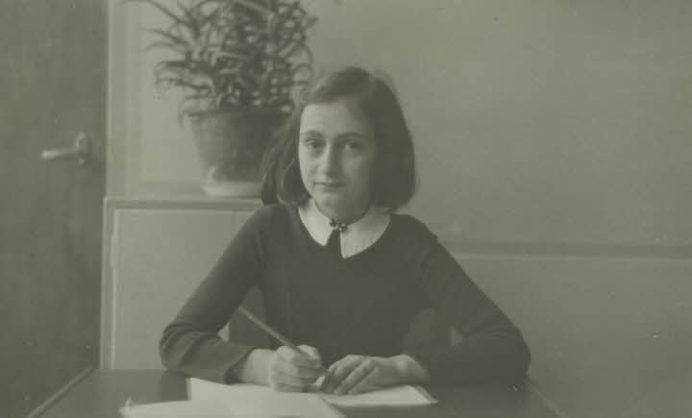
Members of the Annex- The Frank Family
Margot Frank
Three years older than Anne
Attended school in Amsterdam
Sixteen years old when the family went into hiding
In the annex she was known to be quiet, helpful, and studious.
Anne Frank
Youngest daughter of Otto and Edith Frank
Very popular in school
Fond of father, but not close with Margot or her mother
Thirteen years old when the family went into hiding
In the annex, she was known to be a joker, talker, and joyful.

Slide 4
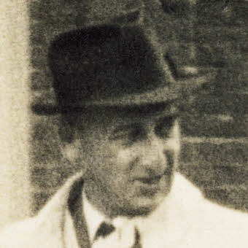
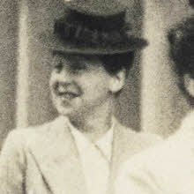
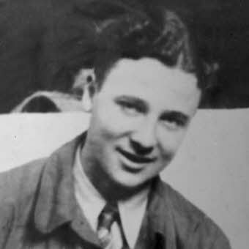
Members of the Annex- The Van Pels
Hermann Van Pels
Worked for father’s butcher business until Jewish businesses were boycotted
Moved to Amsterdam in 1937 and became business partners with Otto Frank in 1938
In the annex he was known for always being hungry, opinionated, and stubborn.
Auguste Van Pels
Born in 1900
Married Hermann in 1925
Known for being attached and fond of personal belongings
In the annex, she was known to be firey, dramatic, and talkative.
Peter Van Pels
Only son of Hermann and Auguste
Sixteen years old when family went into hiding
In the annex, he was known to be reserved, serious, and studious.
*Auguste Van Pels delayed the family’s evacuation because she was so attached to her home and her personal things.

Slide 5
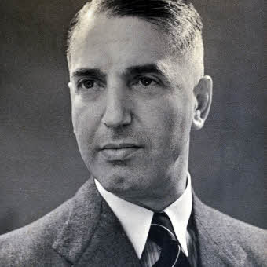
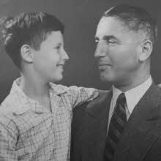
Members of the Annex- Fritz Pfeffer (Mr. Dussel)
Worked as a dentist in Berlin
Married in 1926 and had a son in 1927
Divorced in 1933 and received custody of his son
Wished to marry Charlotte Kaletta, but the Nuremberg Laws prohibited it
Sent his son to England for safety
Forced to go into hiding in 1942
In the annex he was known to keep to himself, write letters to Charlotte, and bicker with Anne.

Slide 6
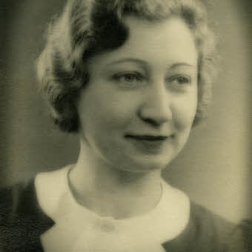
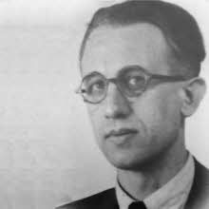
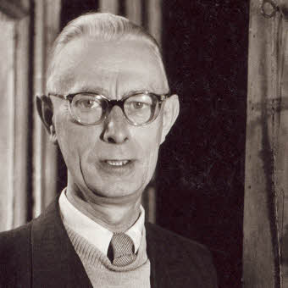
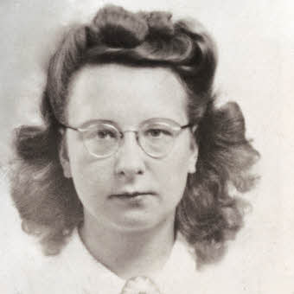
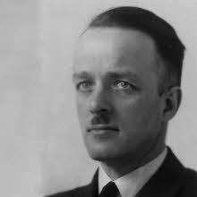
The Help
Miep Gies
Jan Gies
Jo Kleiman
Bep Voskuijl
Ways they helped:
Kept the business running
Brought food
Delivered clothing
Kept the families up to date on news
Provided moral support
Victor Kugler

Slide 7
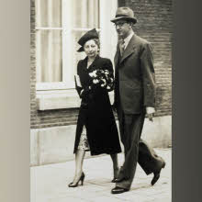
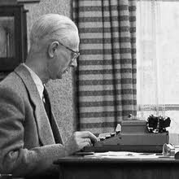
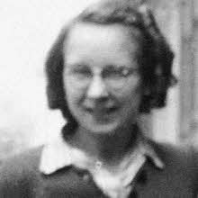
The Help
Jan Gies
The husband of Miep Gies
Arranged food and clothing vouchers for the families
Jo Kleiman
Worked as the accountant for Mr. Frank’s company
Fond and close with Mr. Frank
Suffered from stress induced stomach ulcers most of the time the families were in hiding
Bep Voskuijl
Worked as a typist for Mr. Frank’s company
Brought her father to work in the company as well
Supplied the annex with milk and curriculum supplies for schooling
Close with Anne

Slide 8
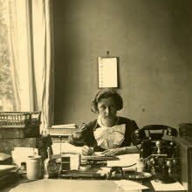
The Help
Miep Gies
Worked as Mr. Frank’s secretary
Close with the whole Frank family
Frequent visitor to the annex
Brought food, news, and boosted morale
Victor Kugler (Mr. Krahler)
Took over as the owner of Mr. Frank’s business to keep it running once The Nuremberg Laws were in place
Supplied the annex with everything they needed, including money from the company
Visited the annex every day
Brought newspapers, magazines, money, and helped keep spirits high

Slide 9
Want more information?
Visit these websites to learn more!!
www.annefrank.org ← GREAT TOOL
https://www.biography.com/people/anne-frank-9300892 ←GREAT INTRO VIDEO
http://www.annefrankguide.net/en-CA/bronnenbank.asp ← QUICK INFO ON EVERYONE

